Slide 1
CIPHENSE TASK 2
Submitted by: Nischay Nirajit Mahanta NIT Rourkela
Gmail id: nischay.nirajit16@gmail.com

Slide 2
Problem Statement
The input is given as a set statement queries where which are excerpts from wikipedia pages. The task is to find the URL of that particular page where all the queries belong.

Slide 3
Approach to the problems
01
On the first note the query statement is taken through a text box using tkinter. It is then sent to the search_query function which stores all the top wiki links
02
After iterating through all the queries the links are kept in a list and then sent to a function check_link_frequency
03
Finally the output is displayed on the GUI using label.

Slide 4
Requirements:-
bs4: used for web scraping
requests: for getting the html format of the page
tkinter: for creating the GUI

Slide 5
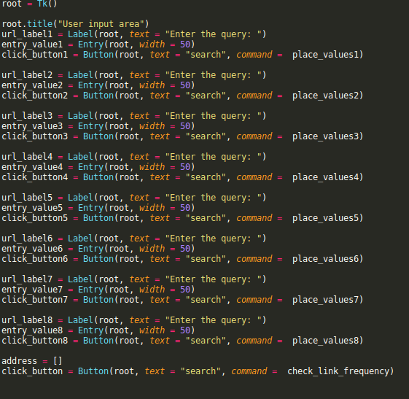
EXCERPTS FROM CODE:
Creation of GUI:

Slide 6
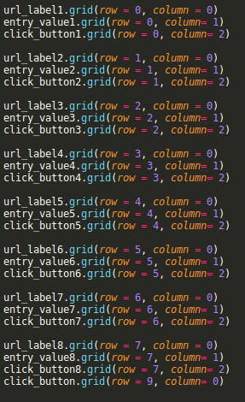
EXCERPTS FROM CODE:
Functionality of GUI:

Slide 7
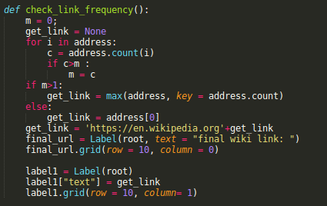
EXCERPTS FROM CODE:
Link_frequency function:

Slide 8
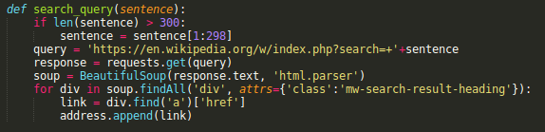
EXCERPTS FROM CODE:
Search_query function

Slide 9
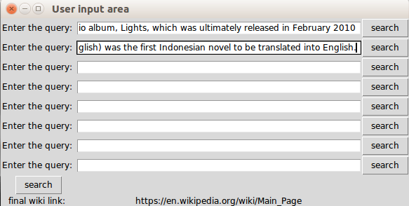
Final Result:

Slide 10
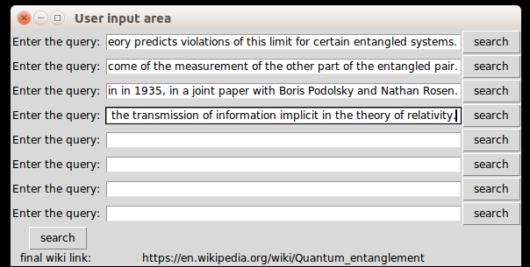
Final Result:

